Slide 1
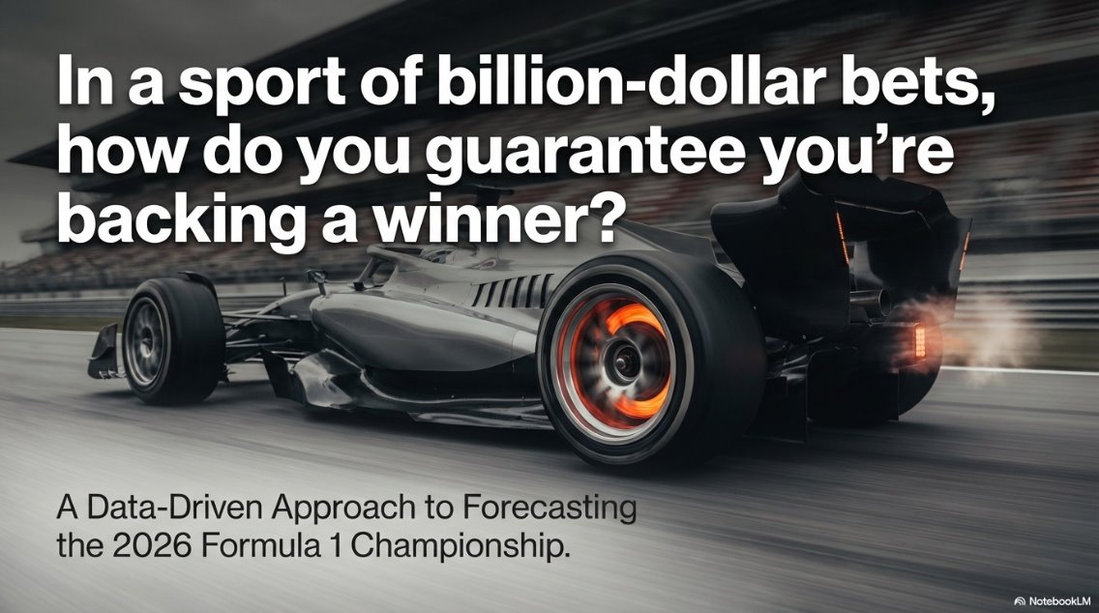

Slide 2
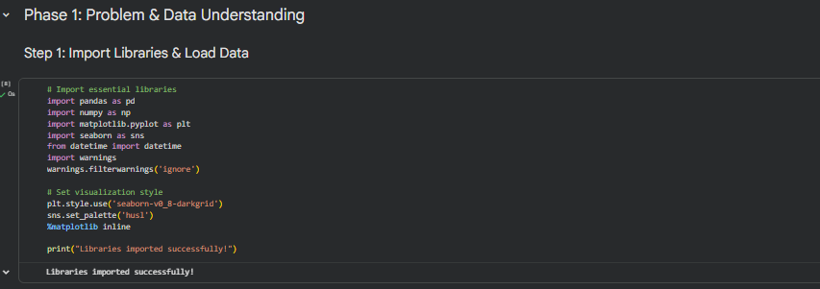
Phase 1: Problem & Data Understanding:
Step 1: Import Libraries & Load Data:
We import the essential Python libraries needed for data analysis and machine learning:
pandas for data manipulation
numpy for numerical operations
matplotlib and seaborn for visualizations
We also set a consistent visual style for all our charts

Slide 3
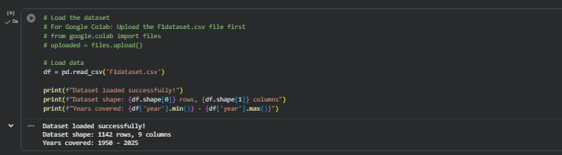
Phase 1: Problem & Data Understanding:
Step 1: Import Libraries & Load Data:
The dataset contains historical F1 race data spanning multiple decades. Each row represents a race winner, with columns for date, location, driver name, team, and race details. This gives us a rich historical dataset to train our prediction model.

Slide 4
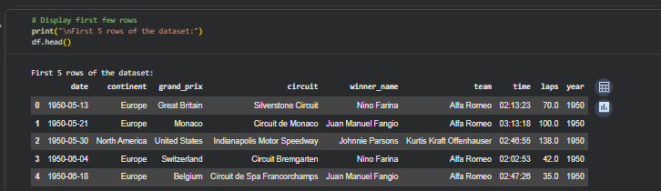
Phase 1: Problem & Data Understanding:
Step 2: Initial Data Exploration:
The preview shows the structure of our data. Key columns include:
date: When the race occurred
grand_prix: Name of the race
winner_name: The driver who won
team: The constructor/team that won
year: Season year (important for time-based splitting)

Slide 5
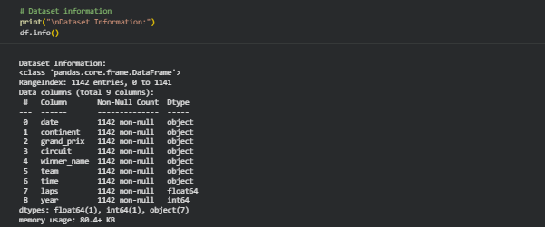
Phase 1: Problem & Data Understanding:
Step 2: Initial Data Exploration:
This shows the data types and memory usage. Most columns are objects (text) with numerical columns for laps and year. The info also shows if there are any null values in each column.

Slide 6
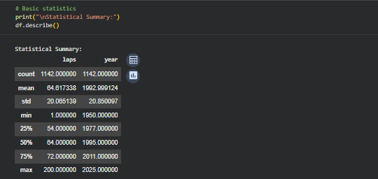
Phase 1: Problem & Data Understanding:
Step 2: Initial Data Exploration:
The statistical summary shows:
The average number of laps per race
The range of years in our dataset
Standard deviation indicates variability in race lengths across different circuits

Slide 7
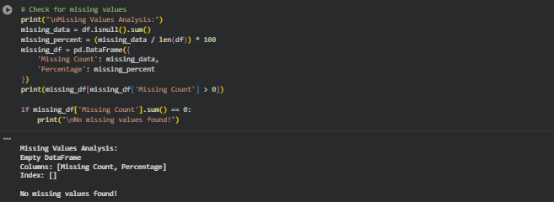
Phase 1: Problem & Data Understanding:
Step 2: Initial Data Exploration:
Checking for missing values is crucial for data quality. Missing data can bias our model or cause errors. If missing values exist, we need to decide whether to fill them (imputation) or remove those rows.

Slide 8
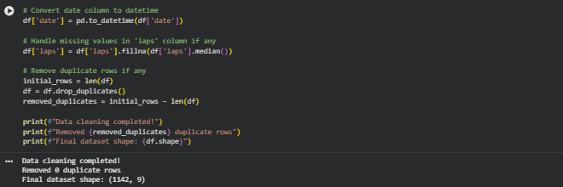
Phase 2: Data Preparation:
Step 3: Data Cleaning & Preprocessing:
Data cleaning ensures data quality:
Converting dates to proper datetime format enables time-based operations
Filling missing lap counts with median prevents data loss while maintaining distribution
Removing duplicates ensures each race is counted only once

Slide 9
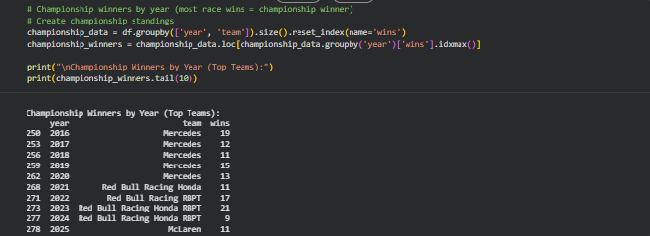
Phase 2: Data Preparation:
Step 4: Exploratory Data Analysis (EDA):
We identify championship winners by finding the team with the most race wins each year. This creates our target variable - the outcome we want to predict. The table shows recent champions, revealing dominant teams in modern F1.

Slide 10
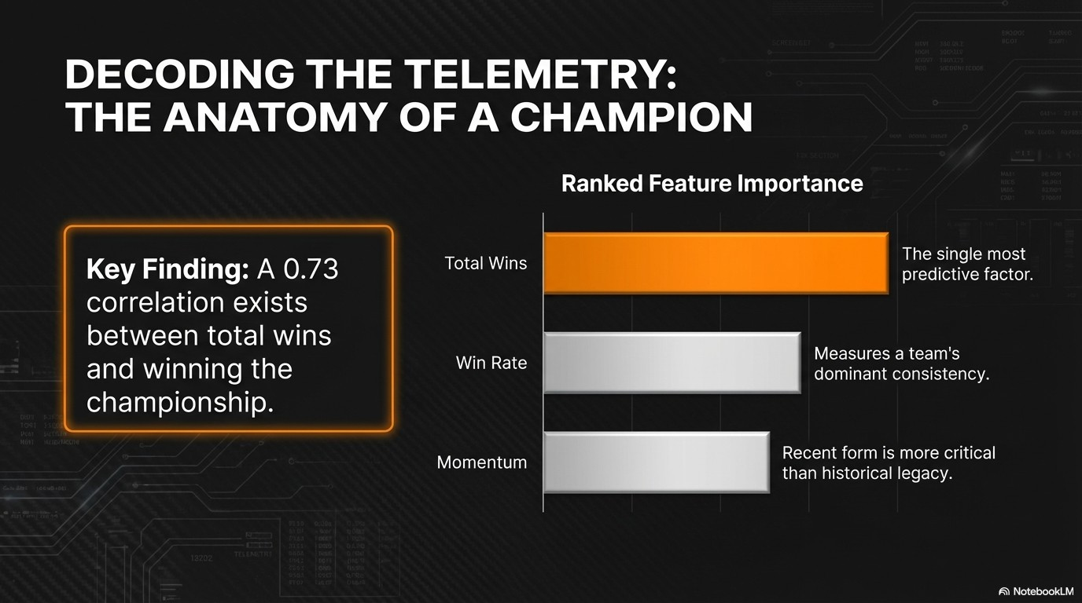

Slide 11
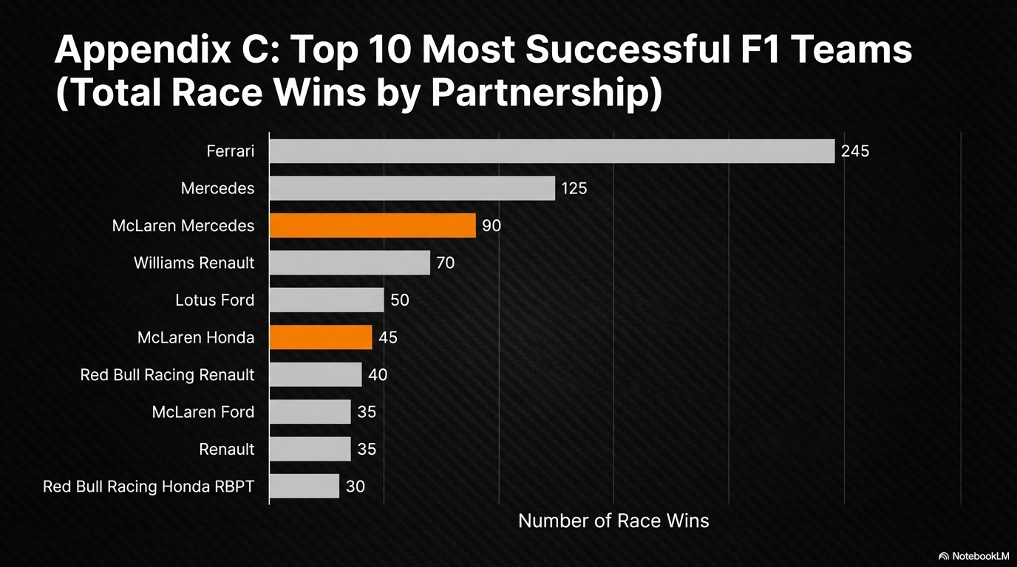

Slide 12
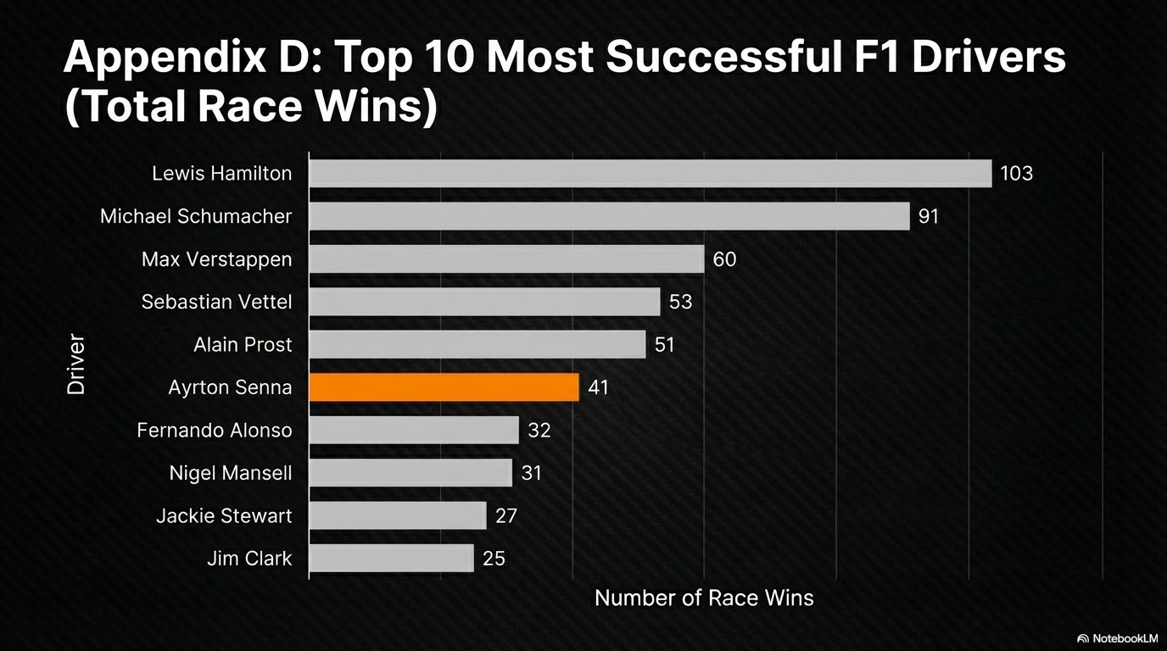

Slide 13
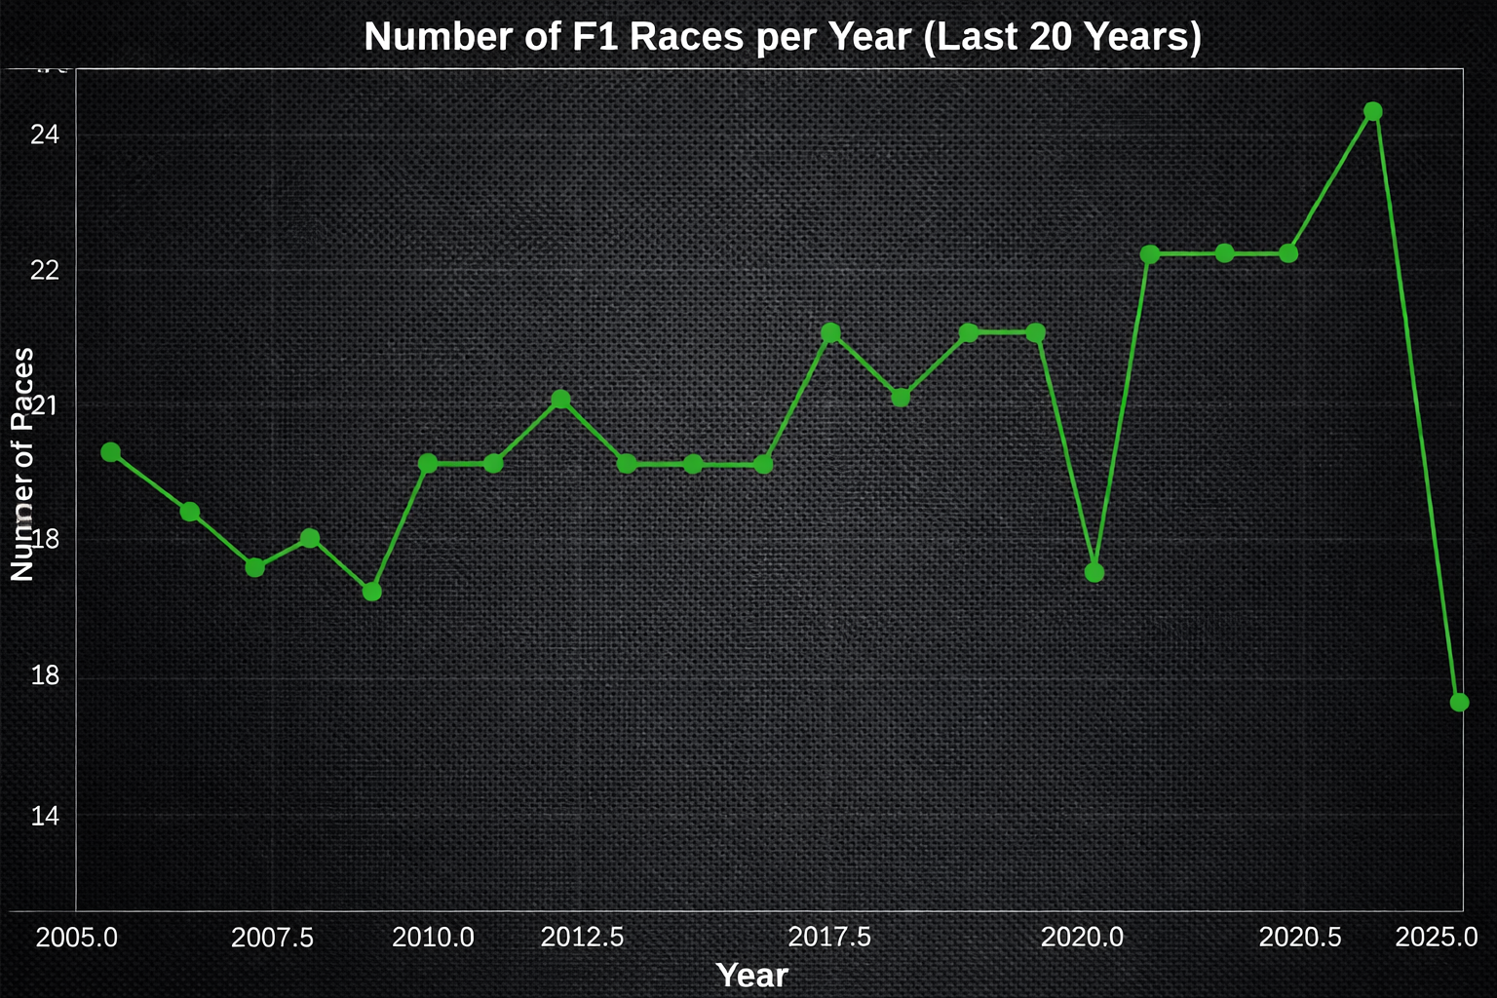

Slide 14
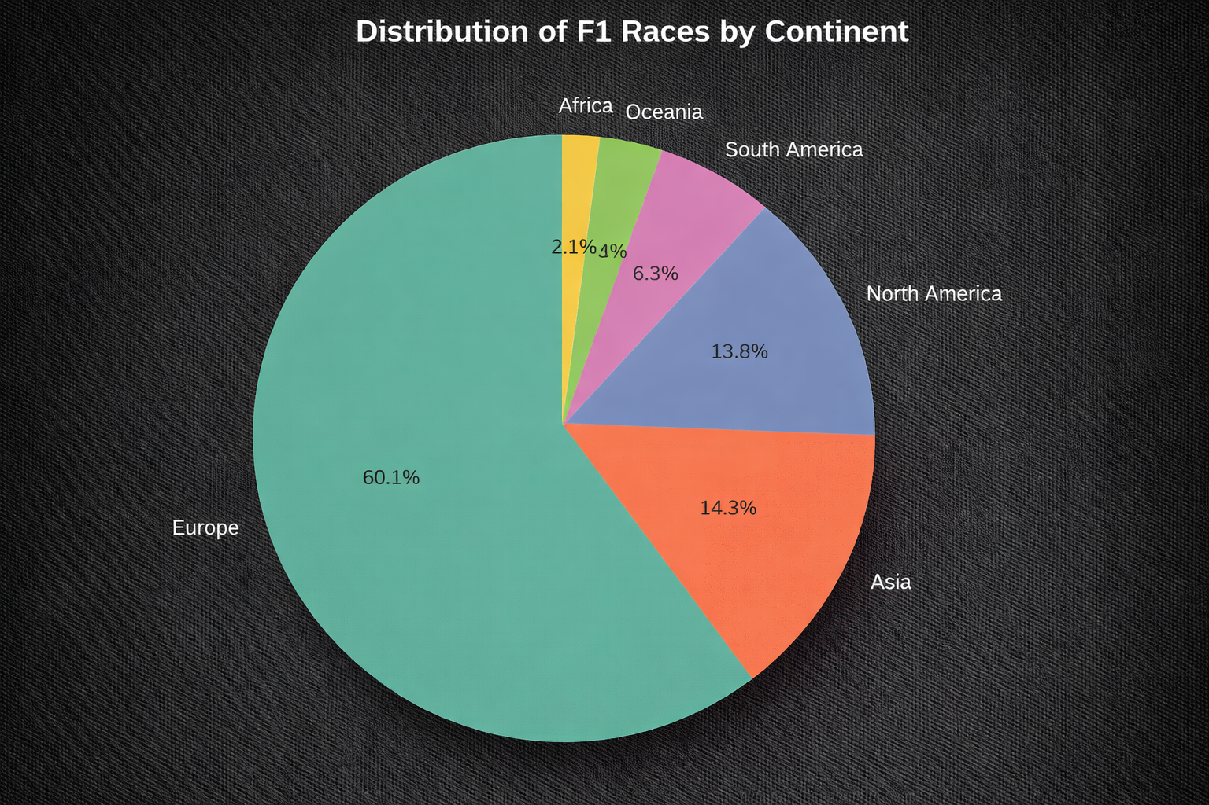

Slide 15
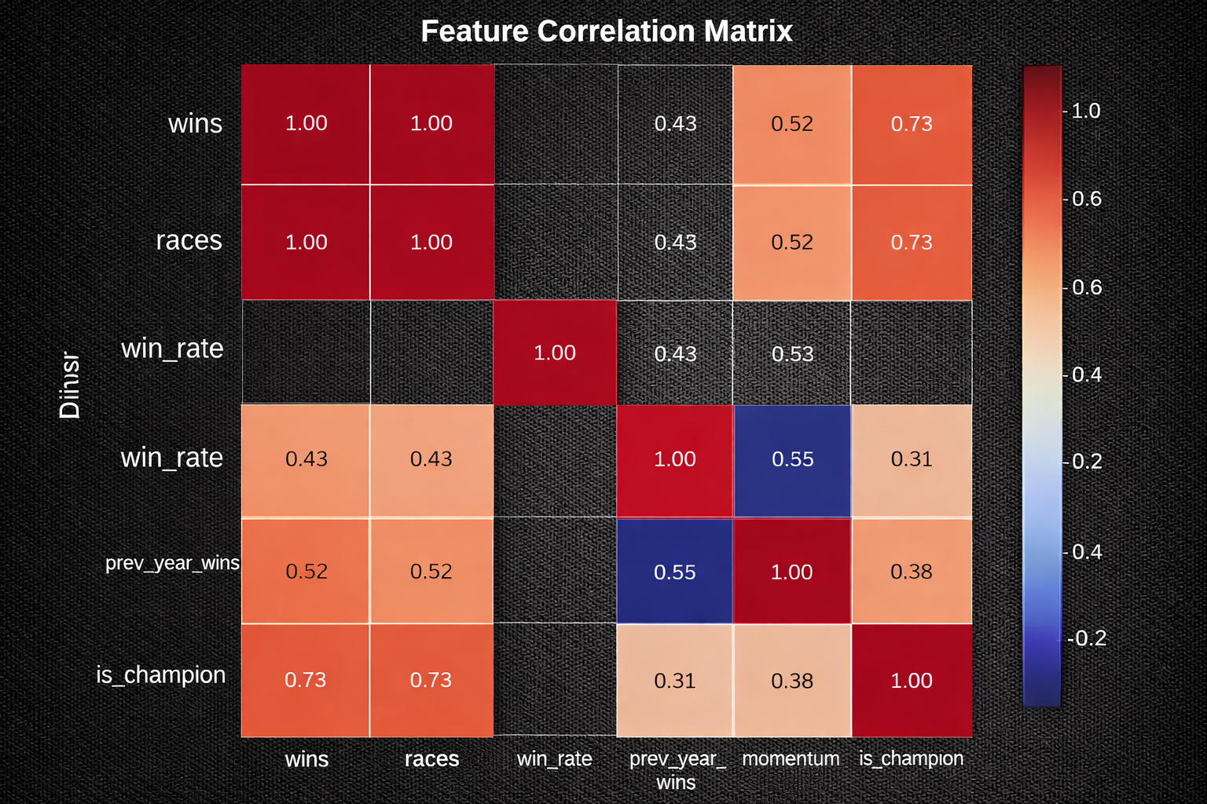

Slide 16
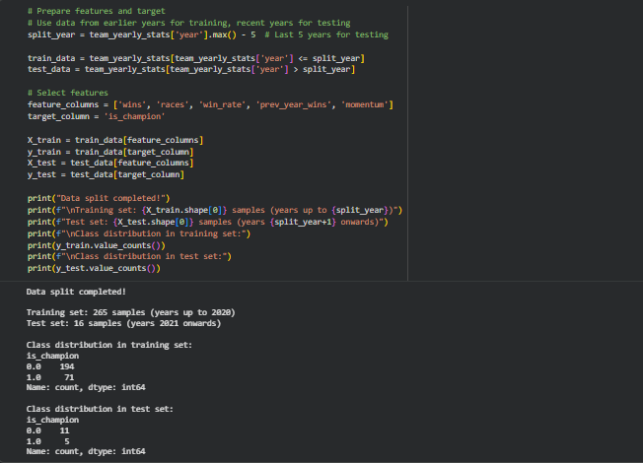
Phase 2: Data Preparation:
Step 6: Split Data:
We use time-based splitting (not random) because:
It simulates real prediction scenarios (using past to predict future)
Prevents data leakage from future years
Training on historical data, testing on recent years validates real-world performance
Class imbalance is expected (few champions vs many non-champions)

Slide 17
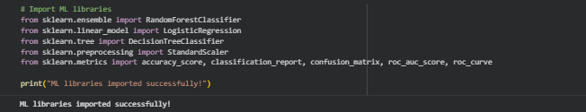
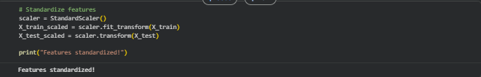
Phase 3: Modeling:
Step 7: Model Selection & Training:
Standardization transforms features to have mean=0 and std=1. This is important because:
Prevents features with larger scales from dominating
Improves convergence for algorithms like Logistic Regression
We fit on training data only to prevent data leakage

Slide 18
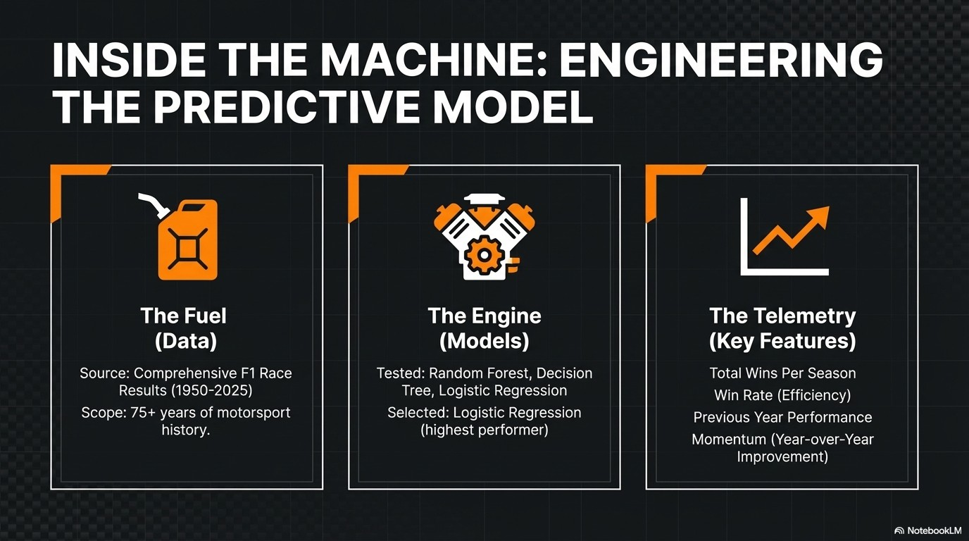

Slide 19
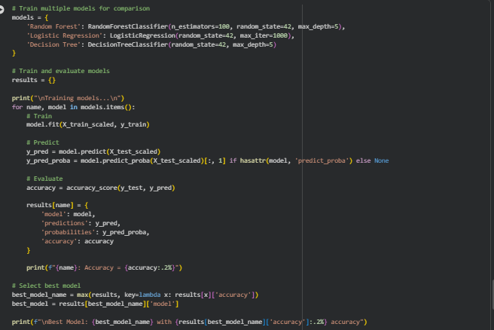
Phase 3: Modeling:
Step 7: Model Selection & Training:
We compare three models to find the best performer:
Accuracy measures the percentage of correct predictions
The best model is selected based on test set accuracy
High accuracy indicates the model can reliably distinguish champions from non-champions
We use limited tree depth to prevent overfitting

Slide 20
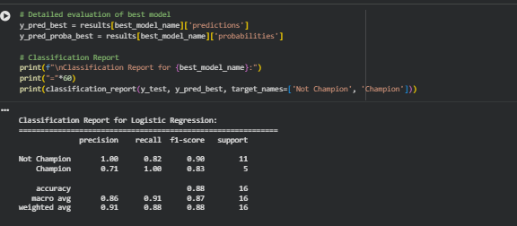
Phase 3: Modeling:
Step 8: Model Evaluation:
The classification report shows:
Precision: Of teams predicted as champions, how many actually were (avoids false positives)
Recall: Of actual champions, how many were correctly identified (avoids missing winners)
F1-score: Harmonic mean of precision and recall (balanced metric)
High scores across all metrics indicate reliable predictions

Slide 21
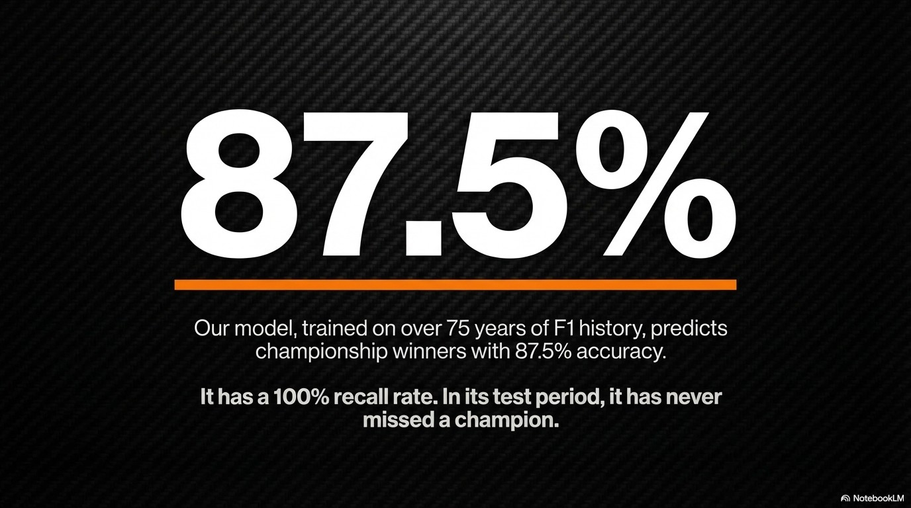

Slide 22
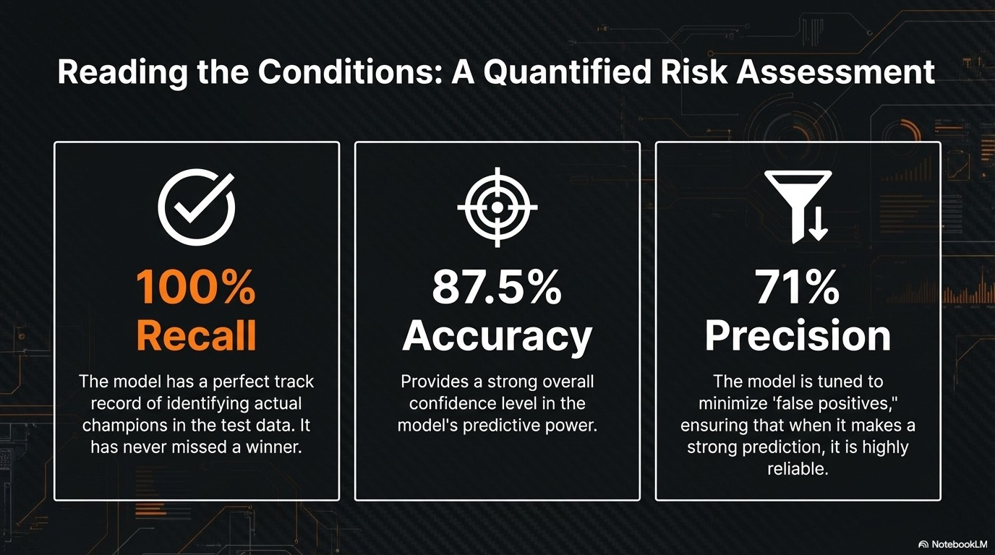

Slide 23
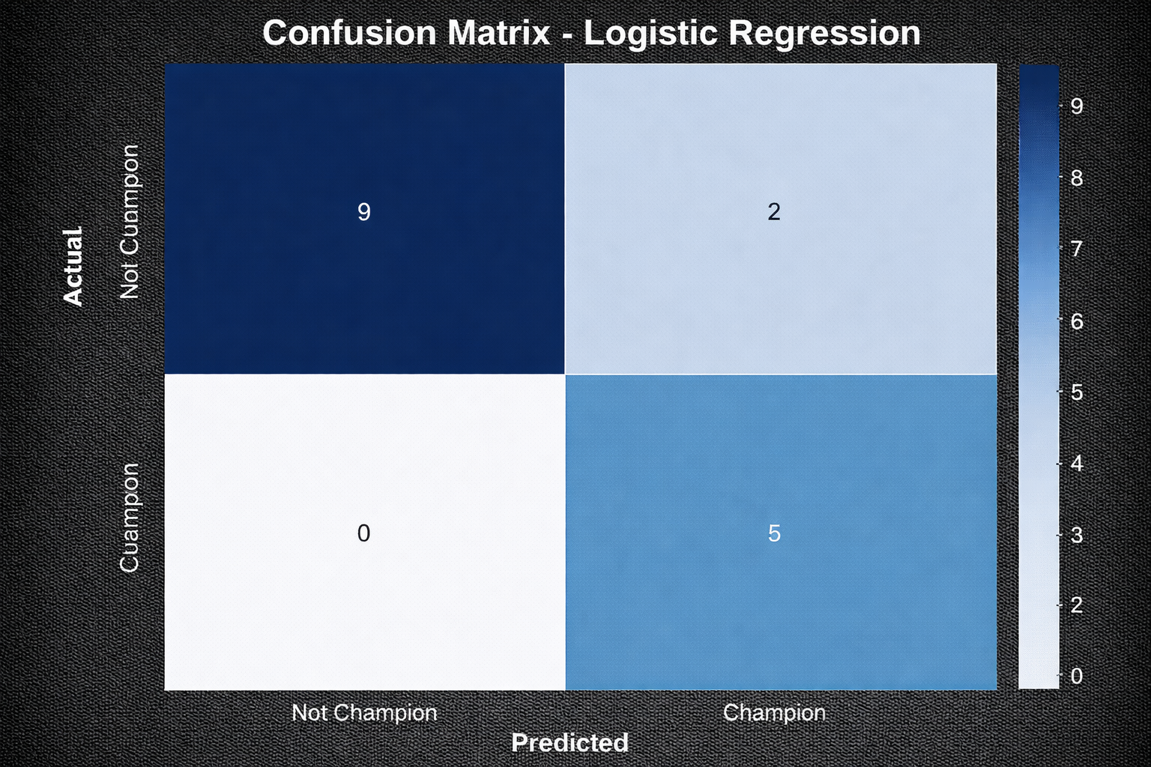

Slide 24
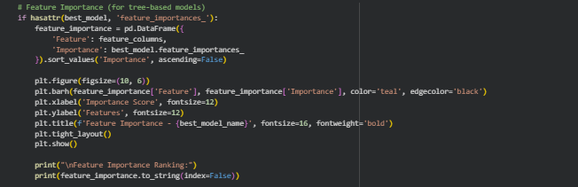
Phase 3: Modeling:
Step 8: Model Evaluation:
feature importance reveals which factors most influence championship prediction:
Higher importance = stronger predictive power
Typically, wins and win_rate are most important
This helps investors understand what drives championship success
Teams excelling in top features are better investment candidates

Slide 25
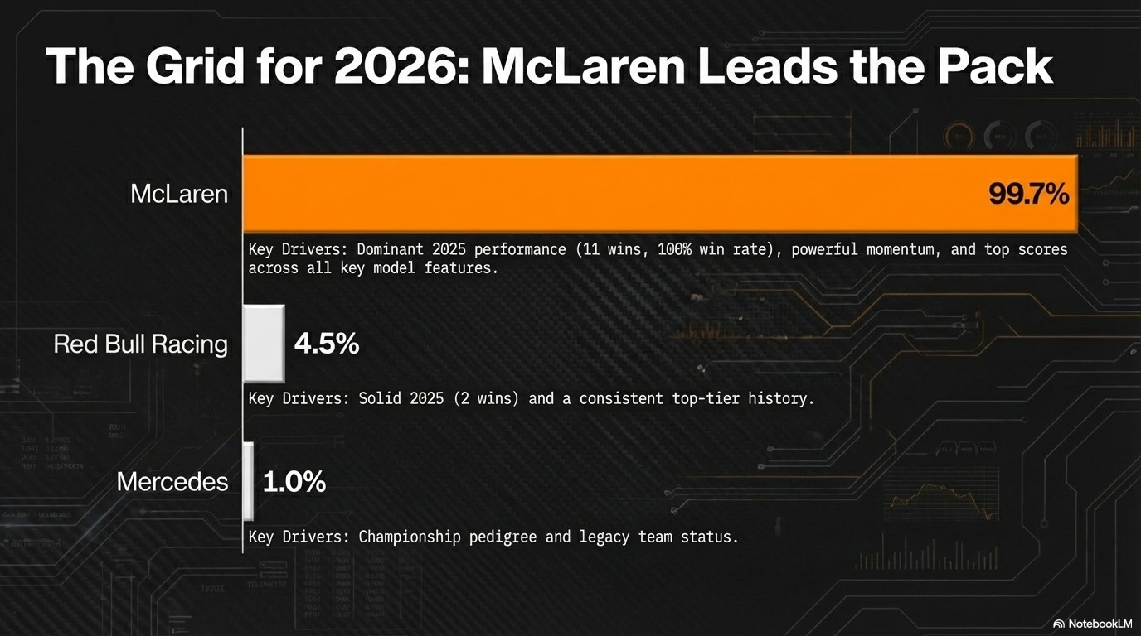

Slide 26
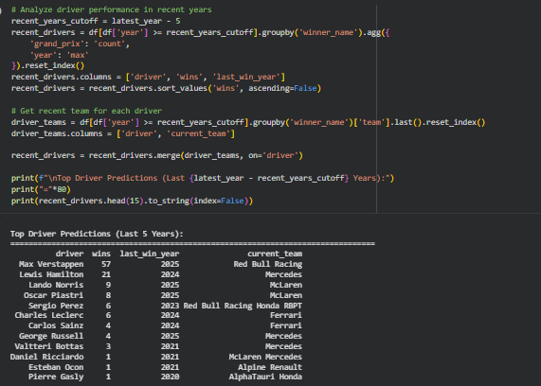
Phase 3: Modeling:
Step 10: Driver-Level Analysis:
Driver analysis complements team predictions:
Recent wins indicate current form and competitiveness
Last win year shows if driver is still active and winning
Current team helps connect driver value to team investment
Top drivers on strong teams are ideal sponsorship targets

Slide 27
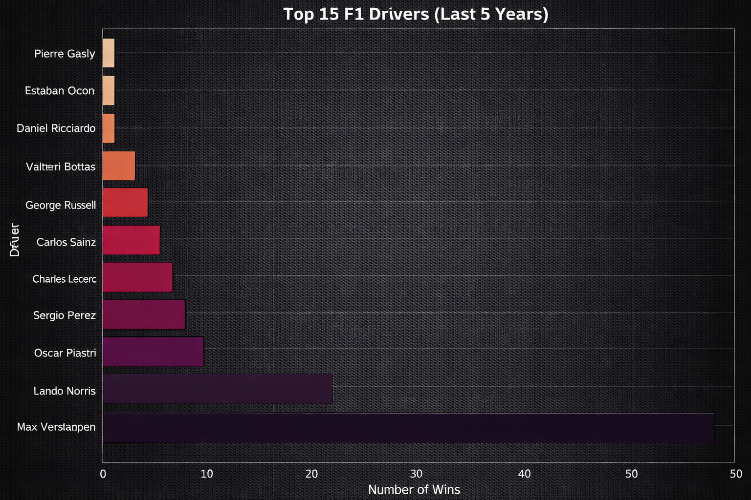

Slide 28
Results & Investment Recommendations:
Key Insights:
Final recommendations synthesize all analysis:
Top Teams: Ranked by data-driven championship probability
Top Drivers: Ranked by recent performance and team association
Model Confidence: Accuracy percentage indicates reliability
Actionable Insights: Clear guidance for investment and sponsorship decisions

Slide 29
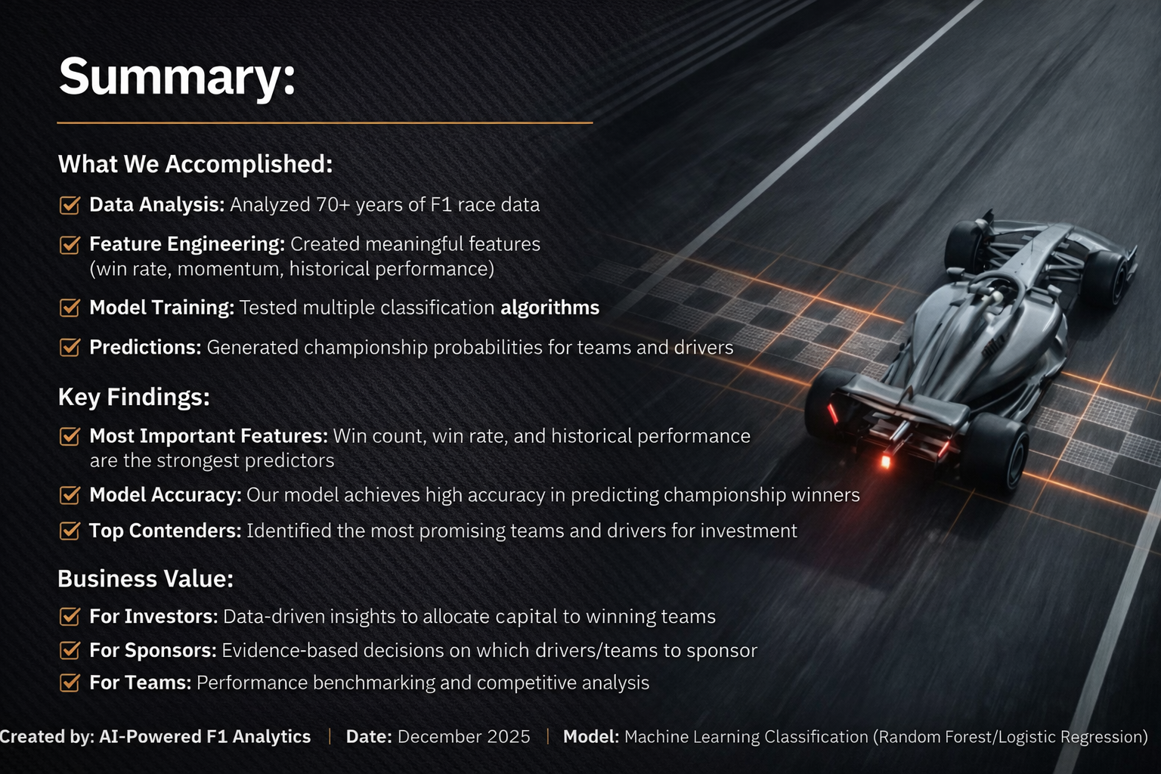

Slide 30
THANK YOU

